Slide 1
Department of Computer Science & Engineering
Shopping Website
Under the guidance of:
Mrs. Yoga Durgadevi Goli Dr. Srivani P
Assistant Professor Assistant Professor
2021-22
EVEN Semester
Jayanth R
Karthik Prabhu
Keval Krishna
Mohammed Yusuf Ismail
1BY20CS073
1BY20CS081
1BY20CS084
1BY20CS116

Slide 2
Introduction
Objectives
Literature Survey
Proposed Methodology
System Architecture/ Design
Implementation
Validation
Future Scope/Enhancement
Department of Computer Science & Engineering
Contents

Slide 3


Introduction
Online shopping is a form of electronic commerce.
Online customers must have access to the Internet and a valid method of payment in order to complete a transaction.
When an online store is set up to enable businesses to gain potential consumers, the process is called business-to-Consumer (B2C) online shopping.
We wish to provide the users with a variety of products from various genuine retailers.
The user will be provided with many choices for the payment mode.
The customer will be able to search for the desired product through the different category mentioned in the navigation bar.

Slide 4

Objectives
Minimize the cost and completely removes the intermediate business layers.
Customer will be able to search for the desired product through the different category mentioned in the navigation bar and also by typing it in the search bar providing the most appropriate search results.
The main objective of our project is to produce a website with variety of products from various genuine retailers.
Our program is also aimed at provided with many choices for the payment mode.

Slide 5
Literature Survey
https://www.myntra.com/ | This online shopping website was used as a reference to create the interface for the frontend development of our shopping website.
https://www.youtube.com/watch?v=xhWHf-bMElk&ab_channel=CodeWithHarry | From this link, we have accustomed ourselves with the concepts of html , CSS and JavaScript and apply it to produce interactive and responsive websites.
https://www.30secondsofcode.org/js/t/algorithm/p/1 | This reference was utilised to understand how to implement string matching and sorting algorithms in JavaScript for an efficient manipulation of data.
https://milanwittpohl.com/projects/tutorials/Full-Stack-Web-App/the-backend-with-java-and-spring | This reference was taken to comprehend the basics of backend of the website using java and spring framework to implement API.

Slide 6

Proposed Methodology
We are creating shopping website clone using HTML, CSS and JavaScript which will have all kinds of products that can be afforded by all classes of society.
Our website will have genuine price system and quality products so that people can be rest free and shop without any regards to fraudsters.
This shopping website will not allow any unverified products to be sold.
It utilizes the algorithms of string matching and sorting.

Slide 7
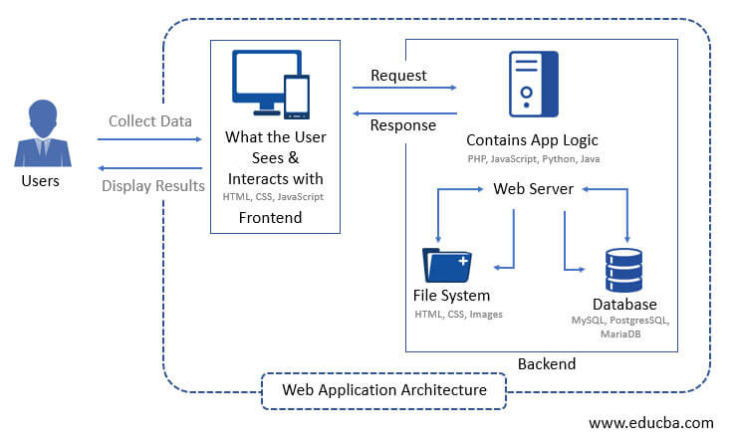
System Architecture and Design

Slide 8
Implementation
USER REQUIREMENTS
Transactions should be secure.
Users should be able to view a complete list of specified items available through the site.
The website is expected to display the genuine price system and superior quality products.
Users should be able to use the eCommerce application from any Web browser supporting HTML 3.2 (or later) and cookies.
SYSTEM REQUIREMENTS
HARDWARE REQUIREMENTS
Processor: Intel i5
Main Memory (RAM): 4GB
Cache memory: 4 MB
Hard disk: 500 MB
Mouse: Optical mouse
Keyboard: compact,108keys
SOFTWARE REQUIREMENTS
Back-end: Java Programming Language
IDE: Visual Studio code
Operating System: Windows10

Slide 9
NON-FUNCTIONAL REQUIREMENTS
The quality of our system is defined by:
Usability – Regardless of the size of your business, the website of your business should be easy to use for even a non-technical user.
Security – Security comes with utmost importance if your site is dealing with monetary transactions, users’ financial and sensitive data.
Performance – The focus should be on loading the e-commerce store as fast as possible regardless of the number of integrations and traffic on your website.
Maintainability – Thriving the website maintenance from the initial development means cutting the time & cost to determine and resolve the faults of the system in the future.
Scalability – It will define how the website can grow and increase its features and functionality without impacting the performance of your website.
FUNCTIONAL REQUIREMENTS
The basic functionalities of our website are:
Product Attributes – It includes different types of product characteristics and the e-commerce development company should know how to implement those features.
Order & Checkout Flow – It is important to mention how the orders will be processed in e-commerce store on the basis of functional requirements.
Social Sharing – Allowing customers to share products, blog posts, and inspirational pictures by adding a corresponding button to the website.

Slide 10
Validation
Test cases
Scenario | Test Step | Expected Result | Actual Outcome
Verify that clicking on any product opens the object with its respective description page. | Clicking on any product to know its description. | Website opening the description of the product clicked. | Website actually opens the description of the product clicked.
Verify that searching a product displays the product using the string matching algorithm. | Searches for desired product in the search box. | Displays the desired product. | The website shows the product searched for.
Verify that the website is able to add products into the cart and place an order. | Adding products into cart for future reference and placing an order for products required. | Website allows the addition of products into cart and placing an order. | Website allows to add into cart and placing an order.
Verify that website allows to finalize product and provide different payment options . | To finalize a product and pay through different payment methods. | Website providing different payment method options and finalizing the product. | Website providing the function of finalizing the product and providing various payment method options.

Slide 11
Output

Slide 12
Future Scope / Enhancement
Users will have more options for the products which are displayed in our website.
Supporting of different Indian languages in future .
Website will become more user friendly.
Provide with the facility of cash on delivery.
Addition of database to our website
Build a medium to communicate with retailers.

Slide 13


